Slide 1
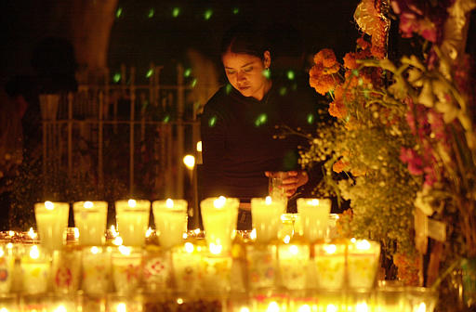
Día de los Muertos
A Celebration of Life

Slide 2
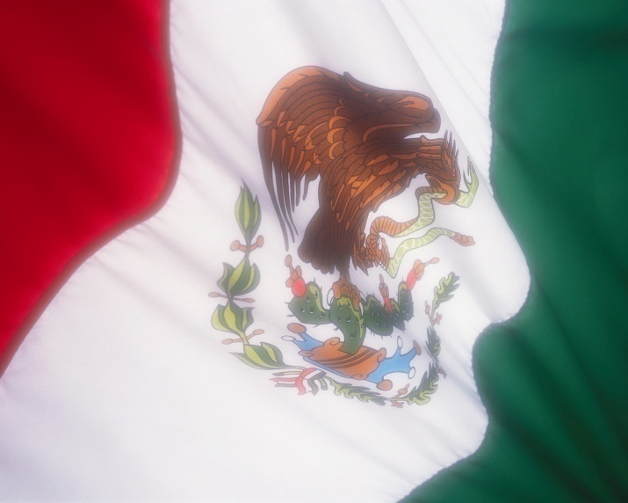
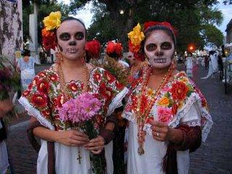
What is the Day of the Dead?
The Day of the Dead is a joyous celebration unique to Mexico. It combines Christian and Pre-Hispanic religious beliefs and traditions. Each family builds a shrine to honor and pay loving tribute to departed family members. Día de los Muertos concentrates on the continuity of life and the devotion of family.

Slide 3
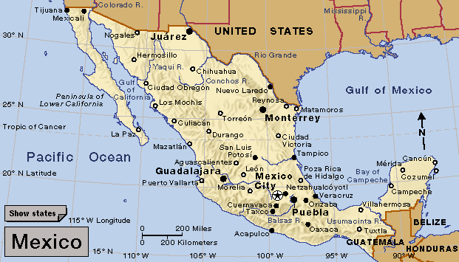
More than 500 years ago, when the Spanish Conquistadors landed in what is now Mexico, they encountered natives practicing a ritual that seemed to mock death.
It was a ritual the indigenous people had been practicing at least 3,000 years.
The Spaniards tried unsuccessfully to eradicate it.

Slide 4
A Change of Dates
In the Aztec calendar, the Day of the Dead ritual fell roughly at the end of July and was celebrated throughout most of the month of August.
After the Spaniards realized they could not eliminate the ritual, they moved it so it coincided with All Saints’ Day and All Souls’ Day (November 1st and 2nd).

Slide 5
What It Is / What It Isn’t
Although they fall on the same days, Día de los Muertos is NOT in any way to be considered as Mexico’s form of our Halloween.
It is, in fact, much closer to our celebration of Memorial Day.
It is also not the only holiday around the world set aside as a day of remembrance. In other countries and cultures, there are similar holidays which pay tribute to the dead.

Slide 6
When is Día de Los Muertos?
Although the main celebration takes place beginning October 31 and ending on November 2, special categories of deceased are honored on the preceding days.
October 28 – Those who died in accidents, suicides, homicides and other violent deaths
October 29 – The unbaptized
October 30 – The lonely soul

Slide 7
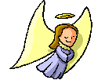
October 31 - Angelitos
On October 31st at 3:00 p.m. the “angelitos” arrive to visit with their family. These are children who died after being baptized. On Día de Los Angelitos, “Day of the little Angels”, the souls of the little children are said to return home. They find an abundance of candies, cookies, milk and honey and other favorite foods awaiting them. Toys are placed nearby for them to play with after they finish eating.

Slide 8
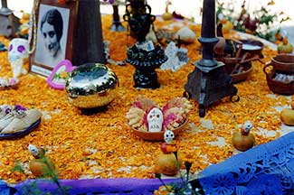
November 1
As the angelitos leave at 3:00 p.m. on November 1st, the deceased adults return and they are given the most elaborate foods and drinks the family can afford. Mexicans believe that light from burning candles, combined with the scents of marigold flowers and copal incense, help returning souls find their way back to their loved ones. Paths of marigold petals are strewn from the cemetery to the door of the house. The dead can find their way by following this bright, colorful path. The spirits are not usually seen, but their presence is said to be felt.

Slide 9
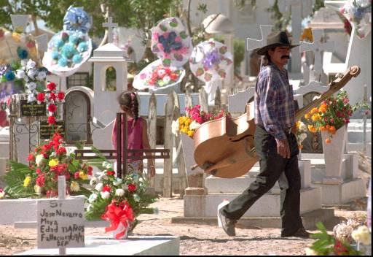
November 2
On Nov. 2nd, families go to the gravesites of their loved ones. This is a day to clean and decorate the tombs in the cemeteries and to spend time with the family buried there. The day is filled with music and festivity to celebrate the dead. In some places, an all-night candlelight vigil takes place beside the graves. This is a festive time and everyone talks of the dead as if they were still alive. It is a way for people to "remember, re-live, and enjoy."

Slide 10
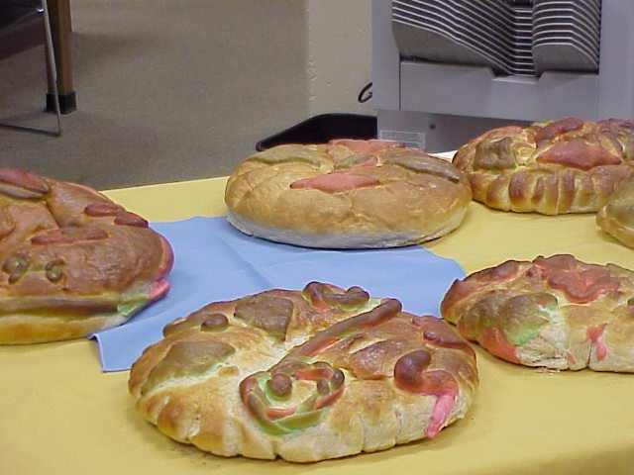
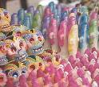
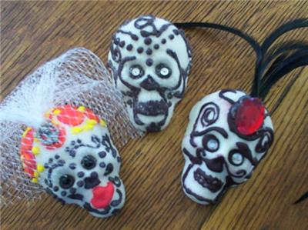
The families tell stories about the deceased at the gravesite. A picnic meal is shared there. The foods are delicious with meat dishes in spicy sauces, chocolate drinks, cookies, sugary treats in a variety of animal or skull shapes, and a special egg-batter bread ("pan de muerto," or bread of the dead).

Slide 11
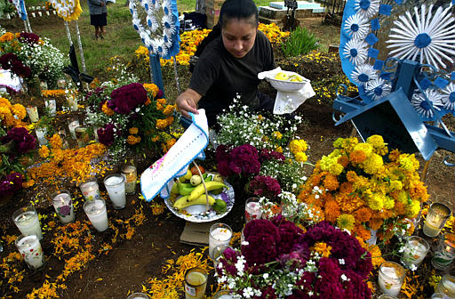
Graves are trimmed with brightly colored wreaths and crosses made with flowers which can be fresh or artificial. The traditional flower for Día de los Muertos is the marigold because its sunny color is a reminder of happy times.
Cempasuchil (yellow marigolds) were the ancient Aztec flower of death.

Slide 12
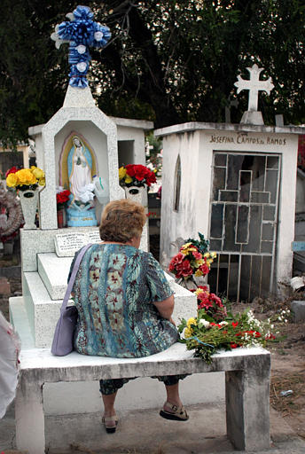
People believe that the souls of their dead do return and are all around them.

Slide 13
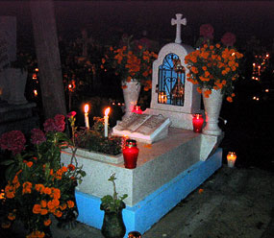
Cemetery Decorations

Slide 15
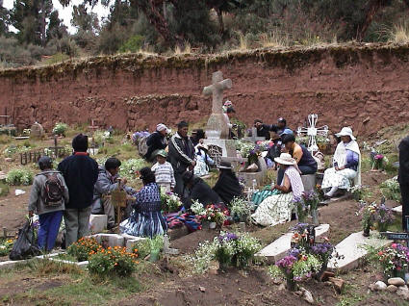
In every region of the country, it is a time for families to come together.

Slide 16
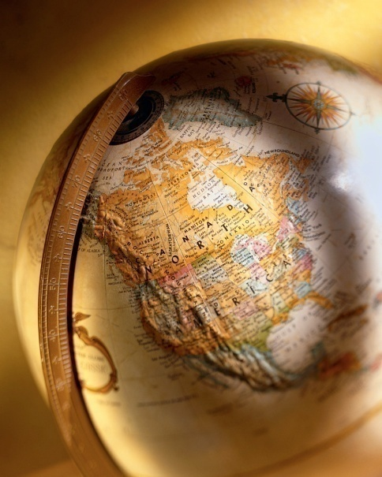
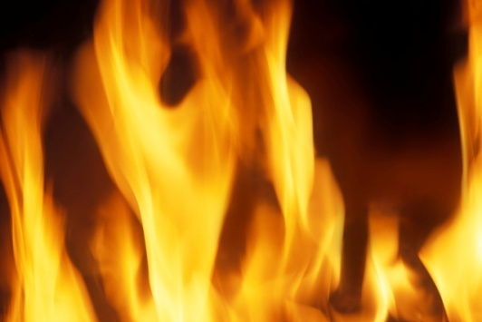
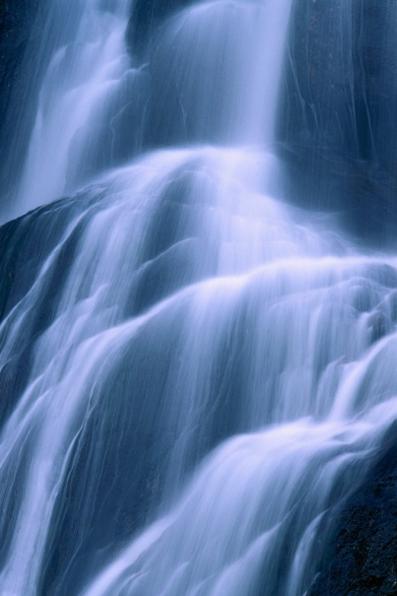
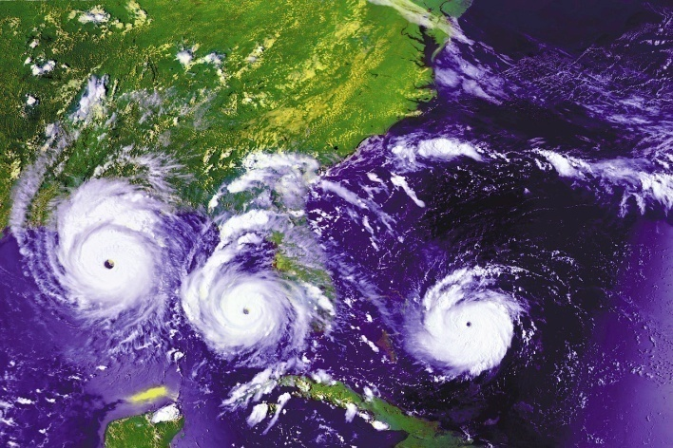
How is the Day of the Dead celebrated?
In every home, families set up an altar (ofrenda) that is dedicated to their departed loved ones. The offerings that are placed on the altar symbolize the four elements:
Earth
Wind
Water
Fire.

Slide 17
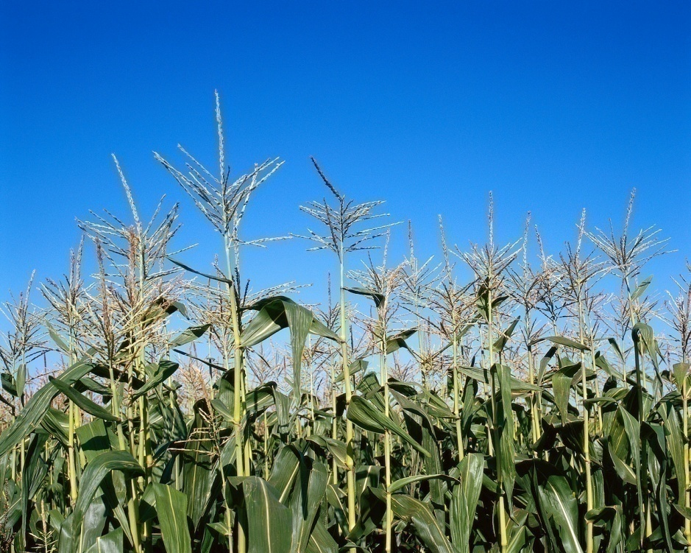
Earth
Mexicans symbolize the earth with crops because they believe that the souls of the dead are fed by the scent of food.

Slide 18
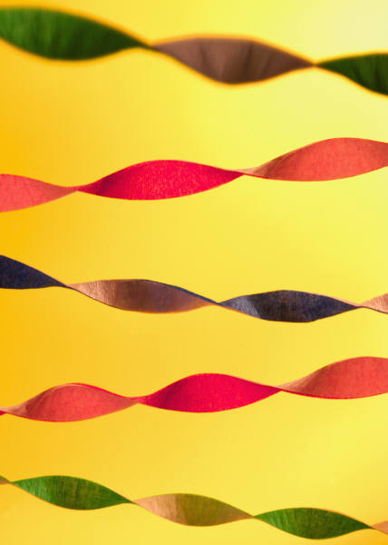
Wind
A moving object is used to symbolize wind. Often tissue paper is strung over and around the altar in streamers to represent the wind.

Slide 19
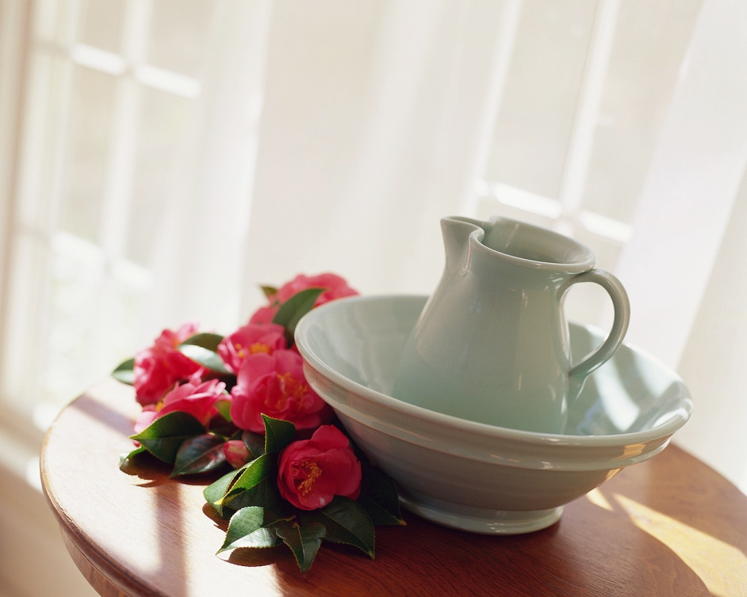
Water
A pitcher filled with water is placed on the altar so the dead can quench their thirst.

Slide 20
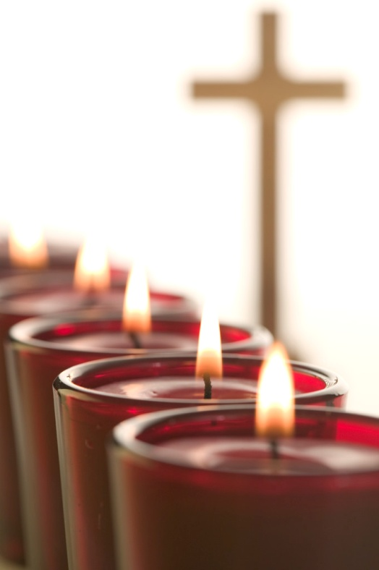
Fire
Mexicans light candles to stand for the souls of their departed. Each lit candle represents one soul and an extra one is lit for any soul who may have been forgotten.

Slide 21
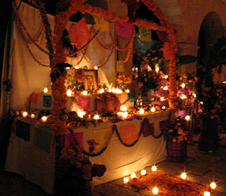
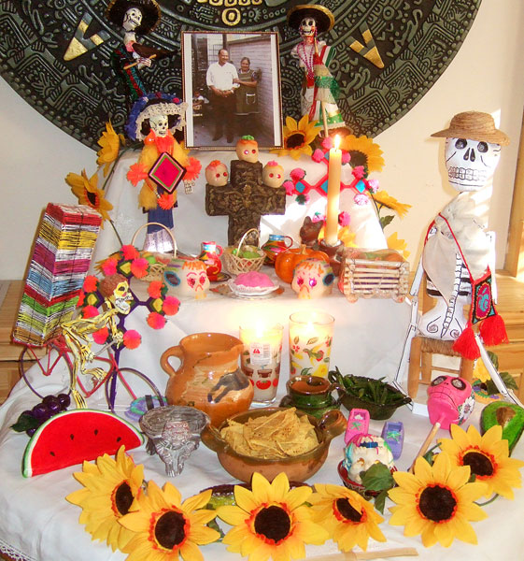
Las Ofrendas
There are many other items placed on the ofrendas which are symbolic of certain aspects of life. In home ofrendas can be very elaborate or quite simple.

Slide 22
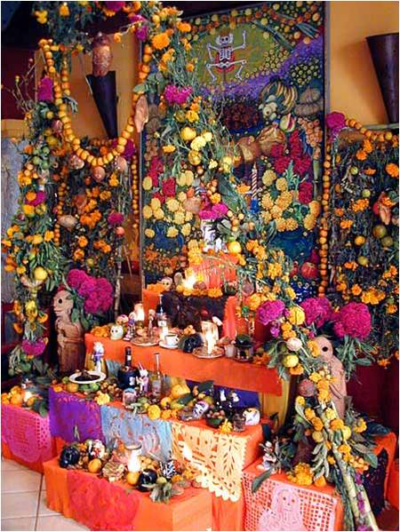

Slide 23
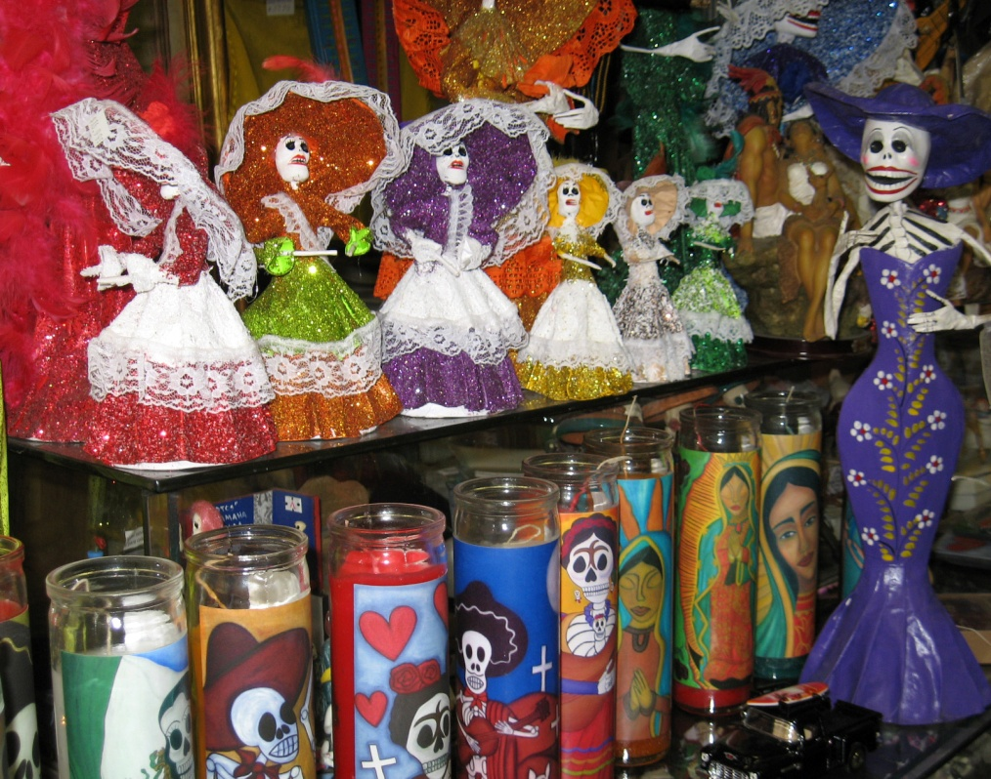
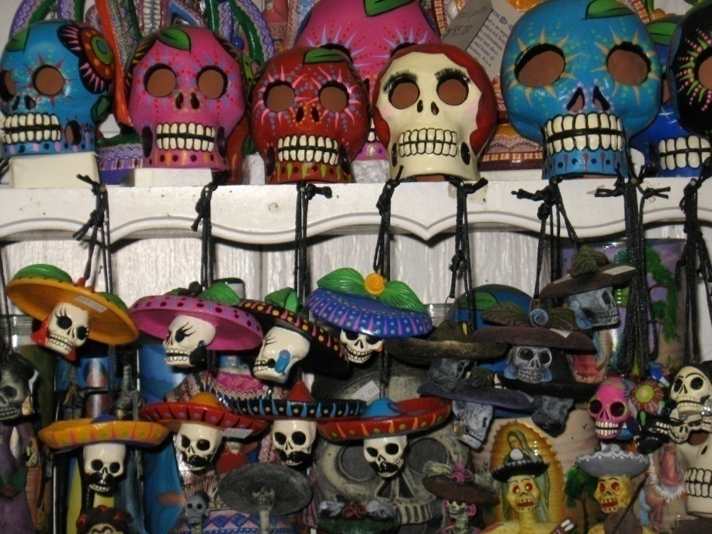
Decorations
From mid-October through the first week of November, markets and shops all over Mexico are full of all the special items for Día de Los Muertos.

Slide 24
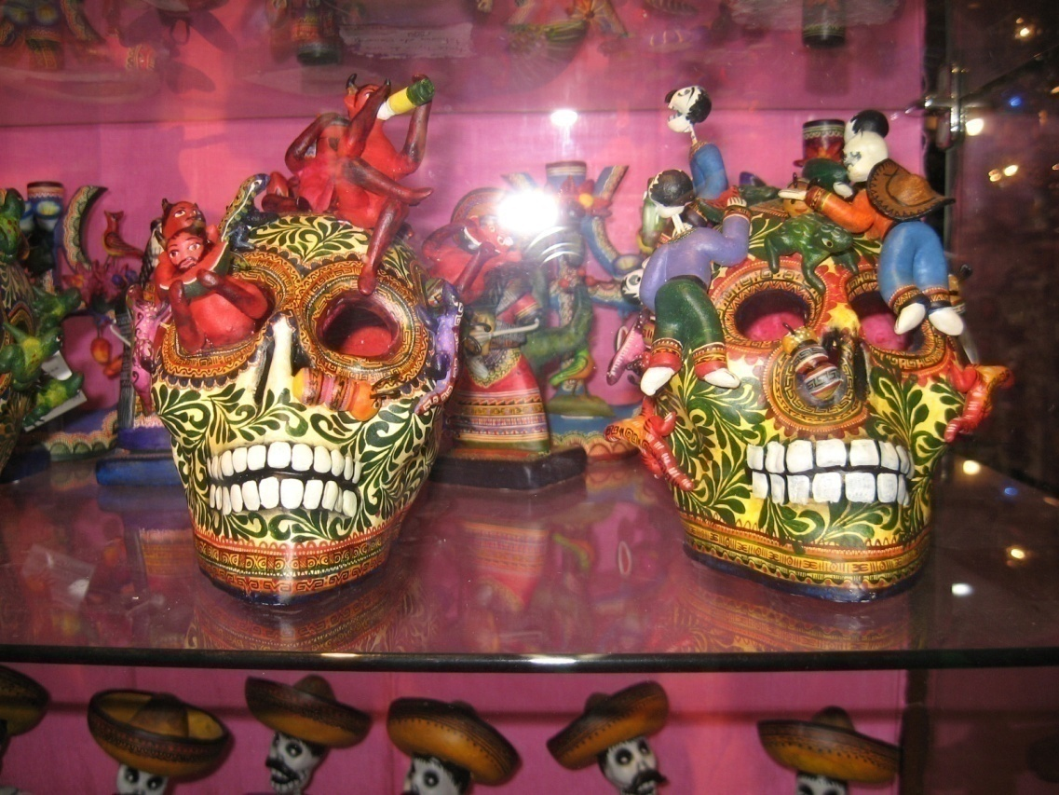
On the lighter side…
El Día de Los Muertos gives the living a chance to poke fun at the morbid side of death symbolized by the “Grim Reaper.” Because of this, skull and skeleton decorations are often seen during the celebration.

Slide 25
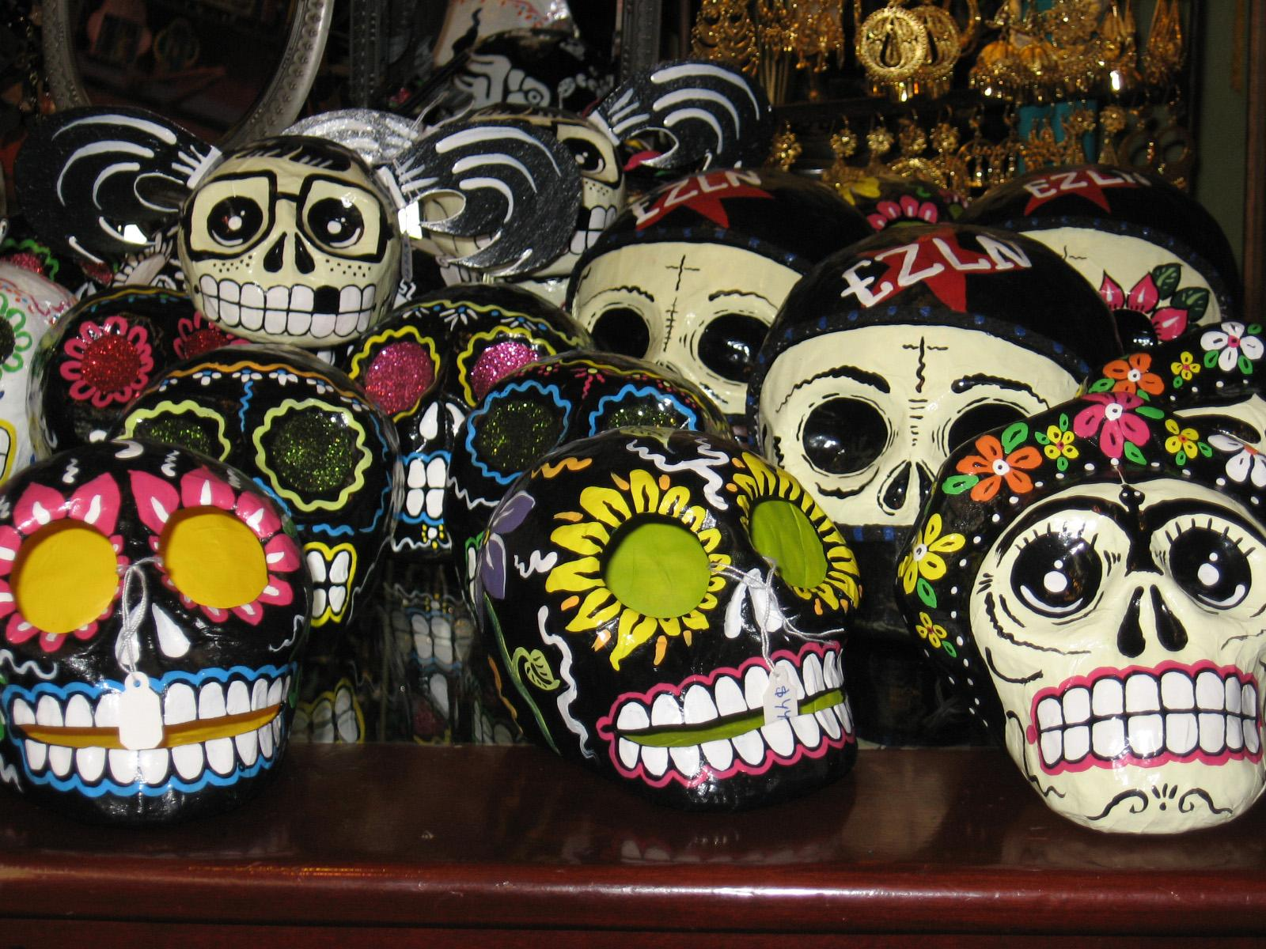

Slide 26
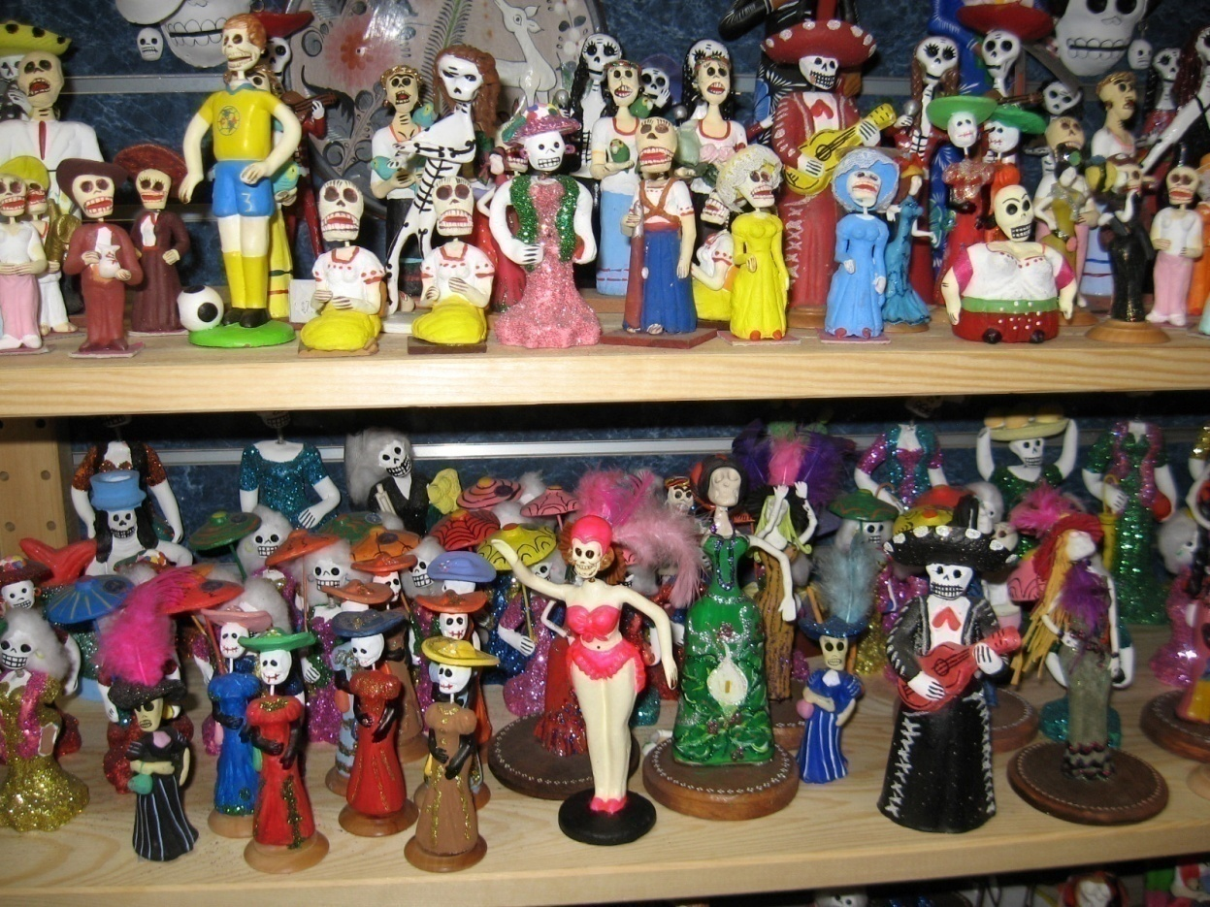
Las Calacas
Handmade skeleton figurines, called calacas, are especially popular. Calacas usually show an active, joyful afterlife.

Slide 27
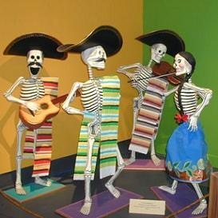
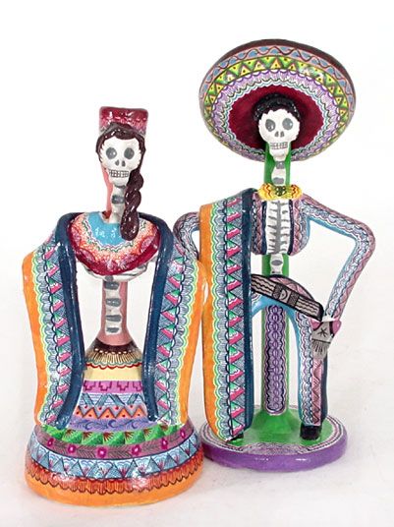
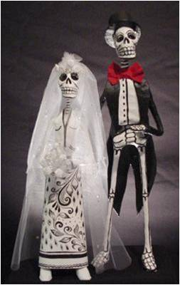
There are figures of musicians, dancers, and even skeletal brides in their white bridal gowns marching down the aisles with their boney grooms.

Slide 28
Sugar Skulls
Sugar Skulls are confections made in remembrance of lost loved ones. There are many different ways to make these sugar skulls. Some are large and thin, easy to break apart and snack on. Some are chocolate and decorated with hard candies. But most of those that are used to decorate the ofrendas and tombs are small, hard sugar skulls, painted with frosting and bits of foil.

Slide 29
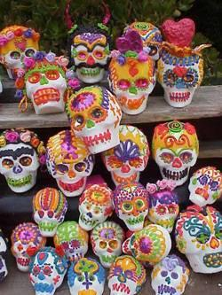
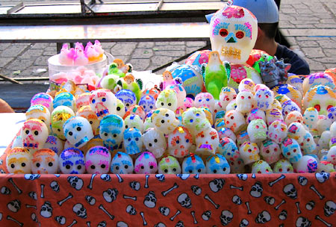
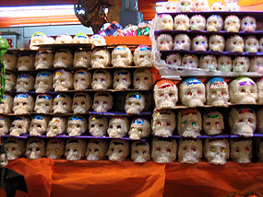

Slide 31
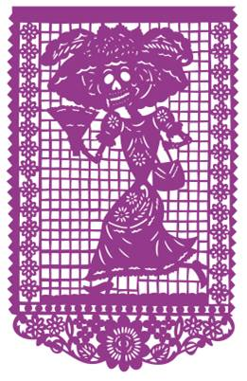
Papel Picado
Papel picado is a particular style of paper-cutting with its own traditions. Aztecs used mulbery and fig tree barks to make a rough paper called "amatl". The art blossomed when tissue paper became available.

Slide 32
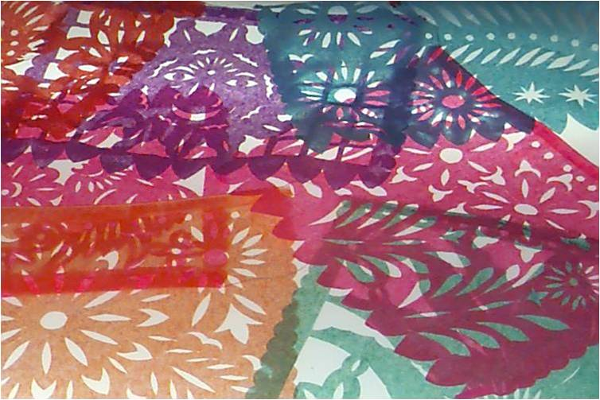
Papel picado artisans usually layer forty or fifty leaves of tissue and then punch designs with special chisels called "fierritos". Sheets of papel picado are hung along strings as banners called "banderitas".

Slide 33
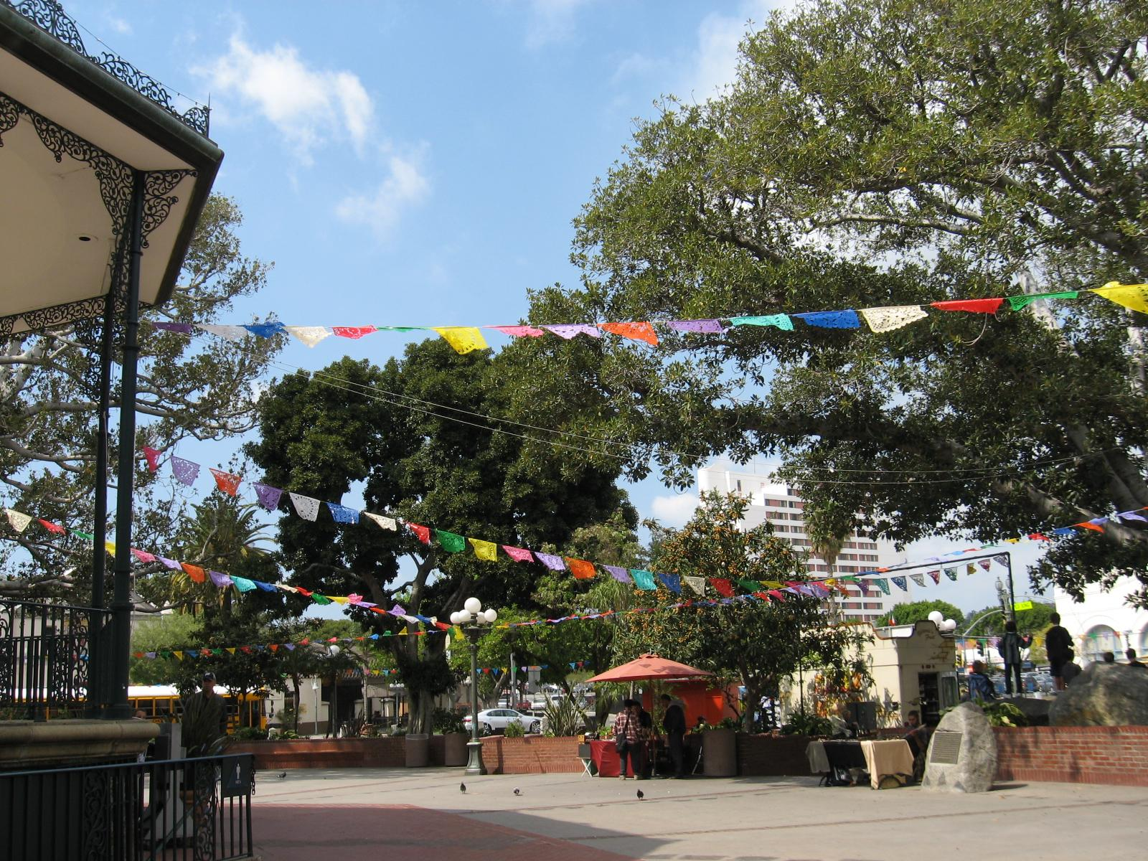

Slide 34
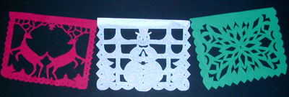
Papel picado is made for many other celebrations besides Day of the Dead. Different celebrations call for different colors and motifs.

Slide 35
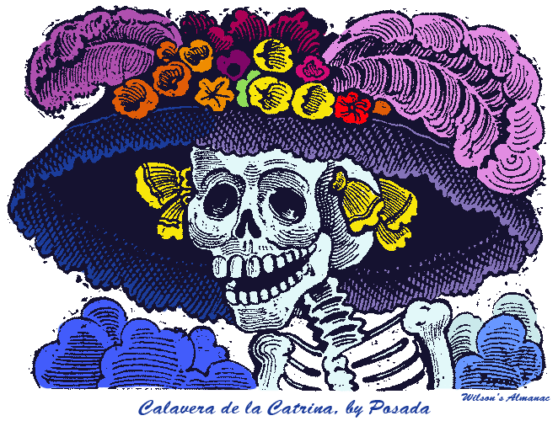
Jose Guadalupe Posada (1852-1913)
José Posada was a Mexican artist whose artwork came to represent the celebration of Day of the Dead. In Mexico, people were either very rich or very poor. His most famous creation, Catrina, represented a wealthy woman dressed in all her finery. But Posada was poking fun at the rich through Catrina by asking in death, what difference will it make if you were rich? After all, you’re still as dead as if you had been poor.

Slide 36
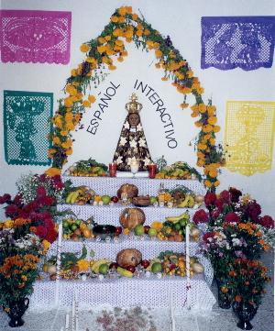
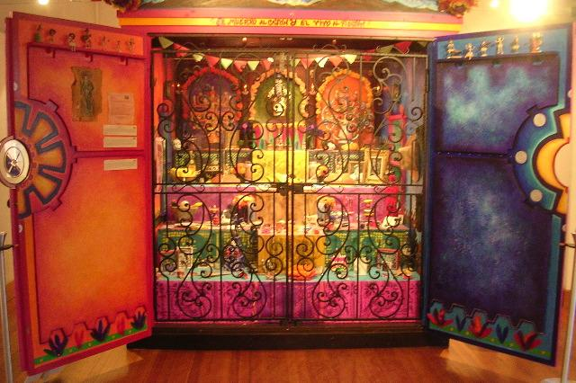
So this commemoration of the dead becomes a family reunion with joyous celebration between the living and the dead. It is an important social ritual, a way of recognizing the cycle of life and death as the true meaning of human existence.

Slide 37
